Slide 1
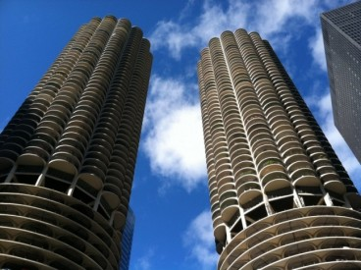
Shanti’s dream vacation
Chicago

Slide 2
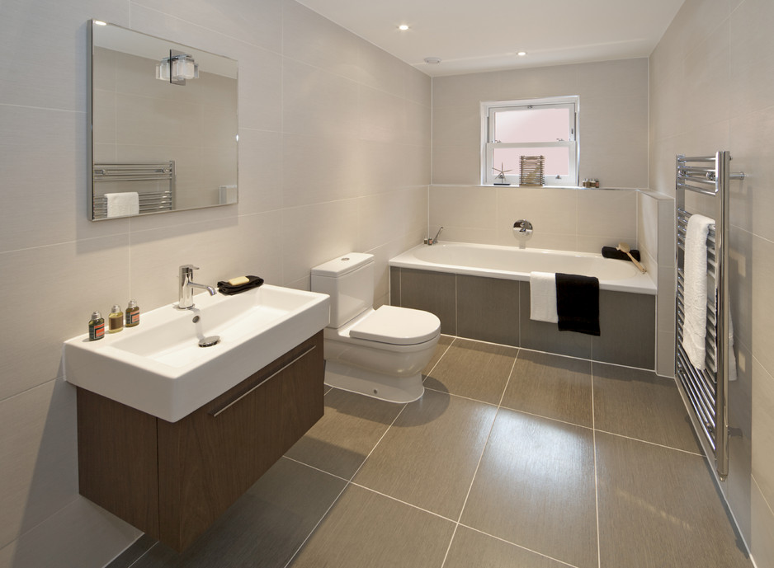
Place to stay
IHSP Chicago $117 a night

Slide 3
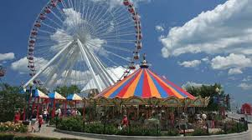
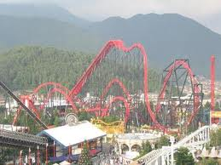
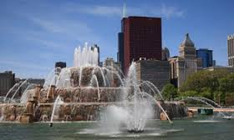
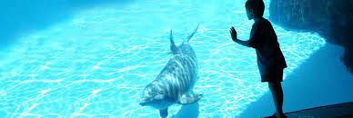
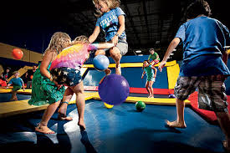
Entertainment
$195 to go to all of the fun thing in this .
$98 to see the whales with my big family.
$103 for my whole family.
$59 for me my brother and sister.
This is free because I would ju7st go and see it.

Slide 4
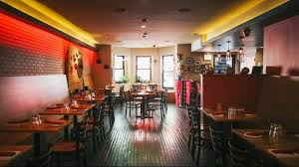
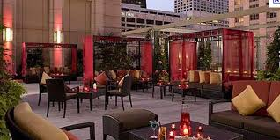
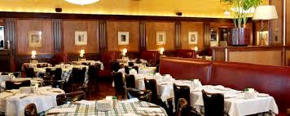
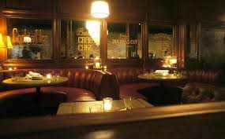
Dining
New rebozo $56
Shanghai Terrace $100
Gibsons Steakhouse $100
Bavettes Boeuf $62

Slide 5
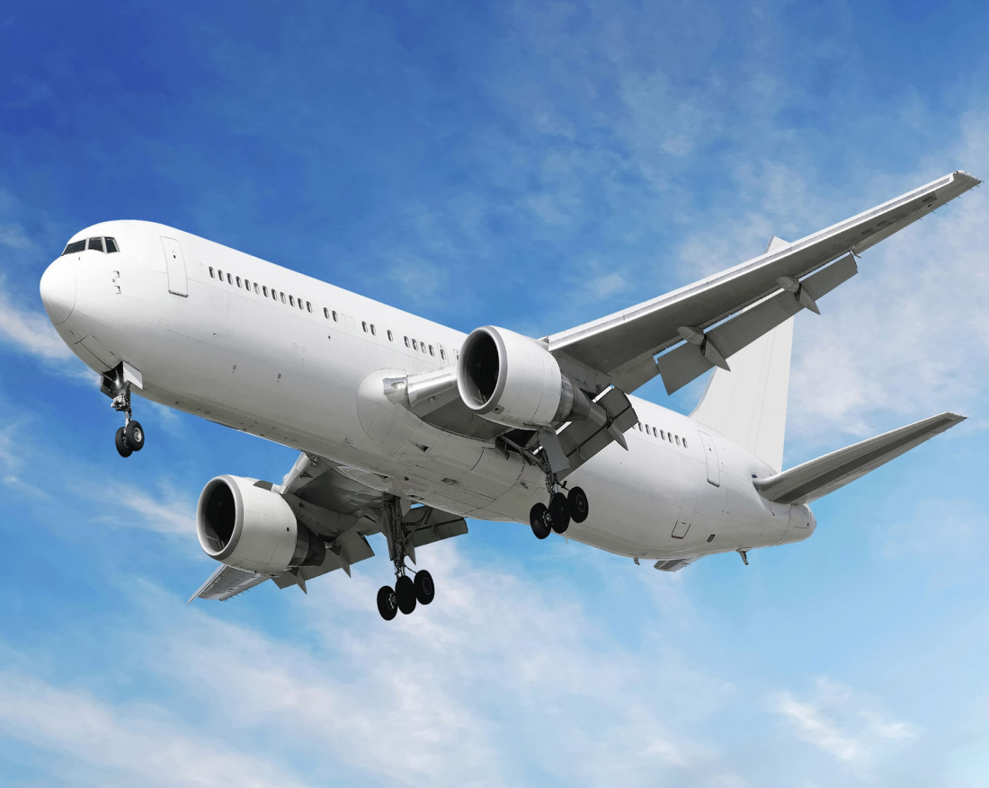
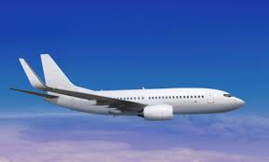
FLIGHTS
I would drive with my family to Winnipeg and drop my car off at my aunties house and she would drive us to the air port so we could fly to Chicago. We would have to get there at 4:39 so that we would be an hour early. My plane leaves at 5:39 and will get in Chicago at 7:46 pm. It will take 2 hours and 7 minutes.

Slide 6
Sources
I used google crome to search. I serched google for all of my pictures. I used google canada to find all of my information.

