Slide 1
My Disney vacation
By Madisyn

Slide 2
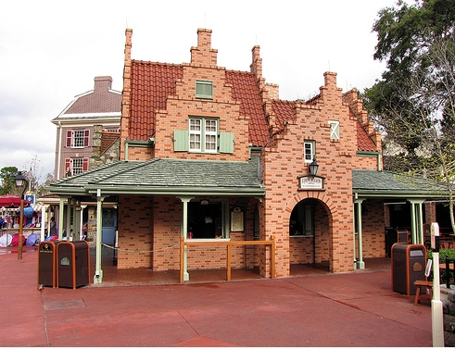
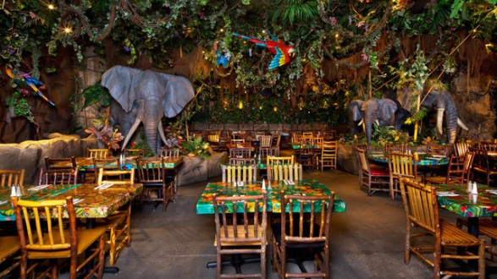
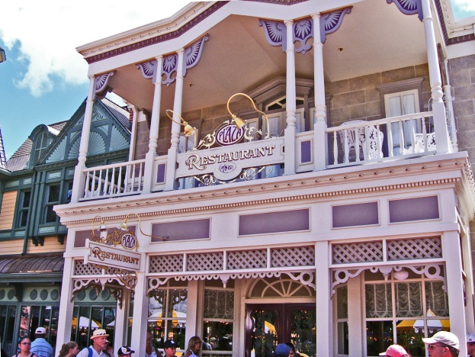
Dining
I will be eating out at Plaza Restaurant , Rainforest café ,and Sleepy Hollow.

Slide 3
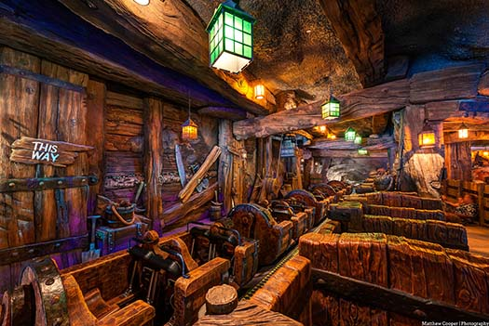
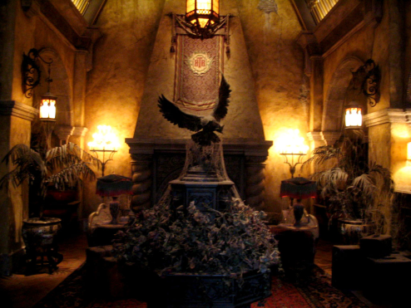
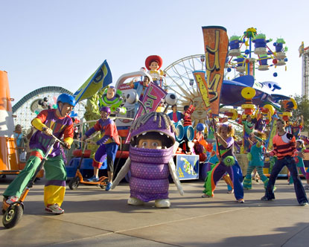
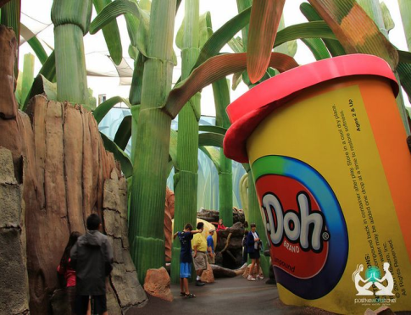
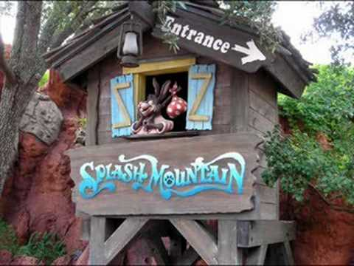
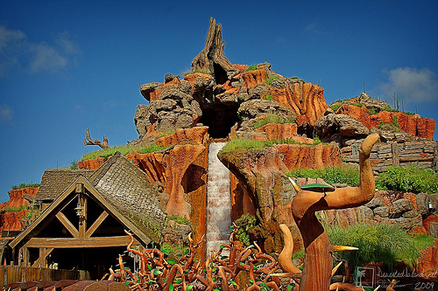
Entertainment
For my entertainment I would like to go to the park called Magic Kingdom and Hollywood Stuidios. In Magic Kingdom I want to go on rides and gift shops, And in Hollywood Stuidios I want to go on The Twilight Zone Tower of Terror. And splash mountain

Slide 4
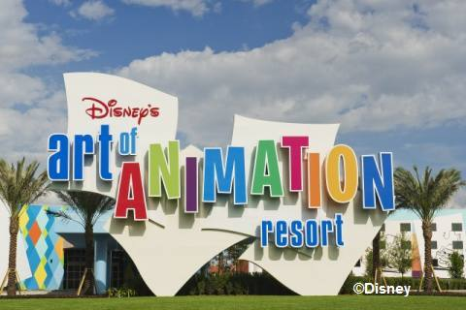
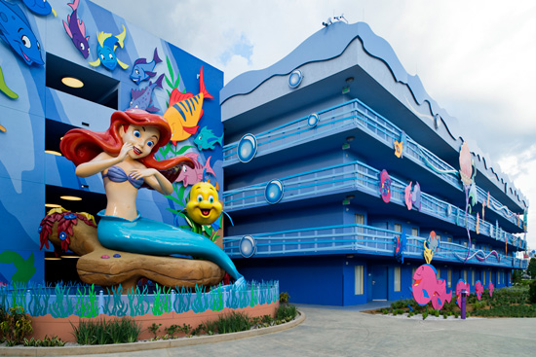
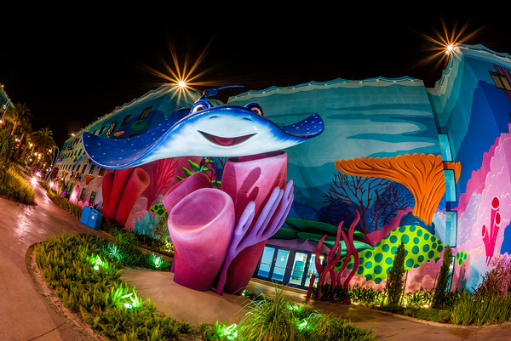
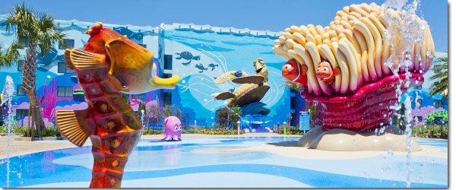
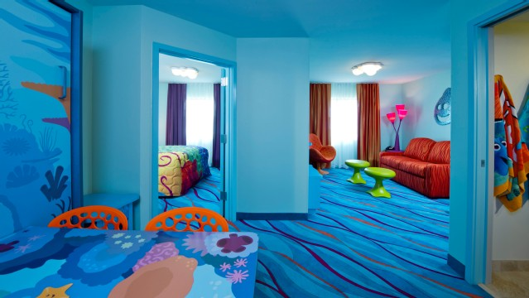
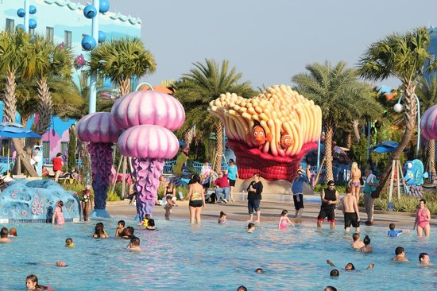
Hotels
I am staying at the Art and Animation hotel in the Finding Nemo Suite. It will cost 408 dollars us.

Slide 5
Flights\Costs
5:15 am 8:37am 2h 22min flight price
Winipeg to Toranto 551$
1h 58min stop before plane to Orlando
10:53am 1:19pm 2h 44min flight
551.91 round trip

Slide 6
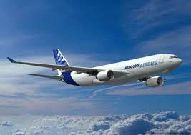
Transportation
I will be driving to Winipeg then flying out to Toronto then to Orlando.
to

Slide 7
Sourses
.Google images
.
Hhh/ Disneyworld.com

