Slide 1
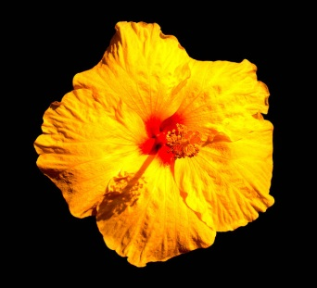
Keira`s dream vacation in
Honolulu Hawaii

Slide 2
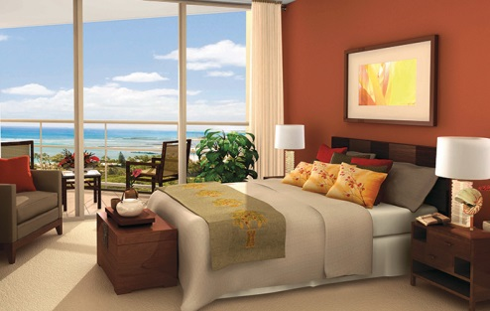
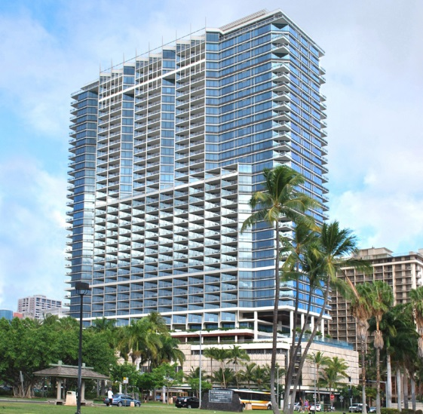
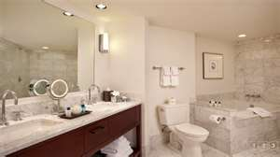
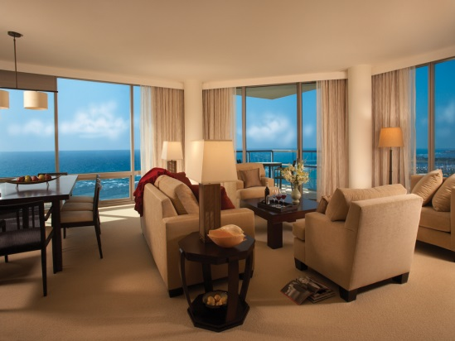
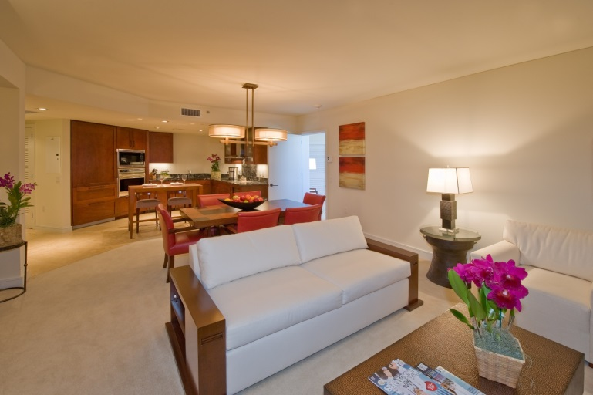
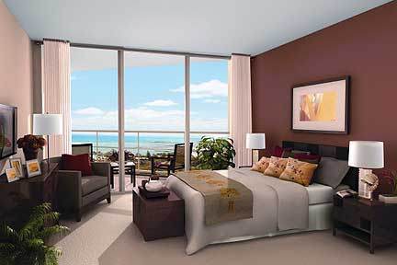
Where I’m staying
I’m staying at the trump Internationol Waikiki beach walk Hotel
It’s going to cost
$506 per night

Slide 3
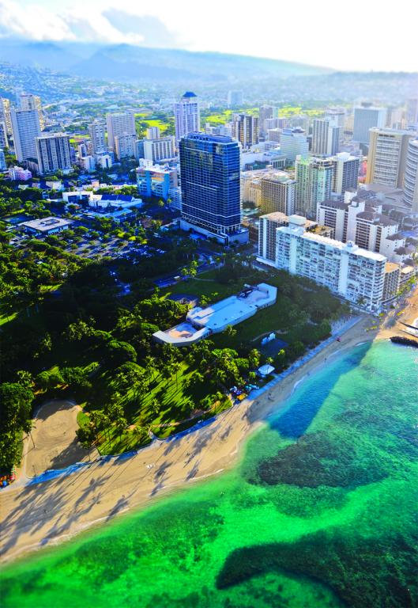
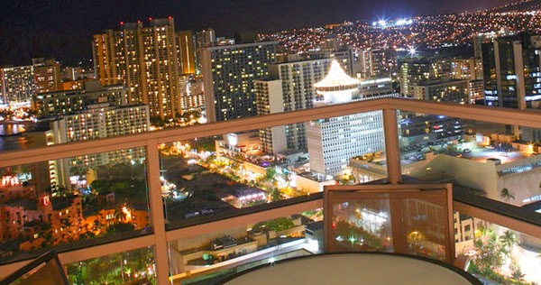
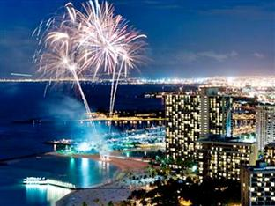
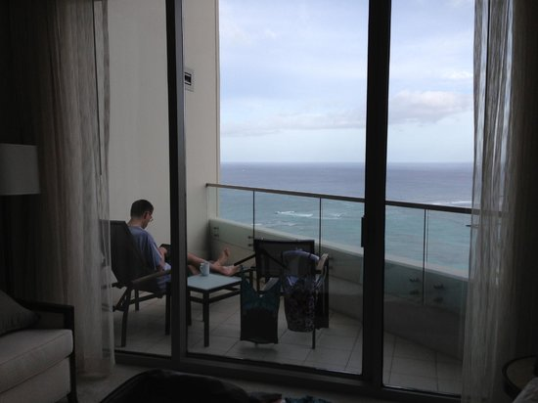
The view from my hotel

Slide 4
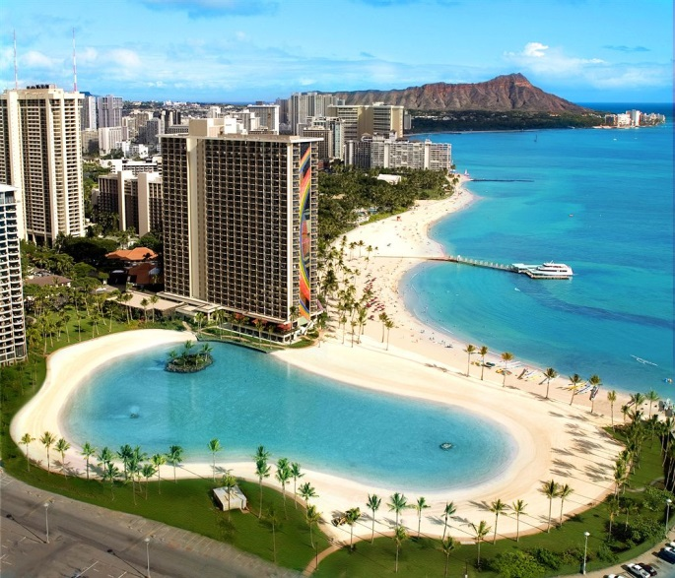
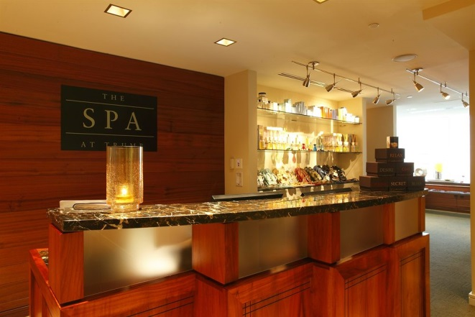
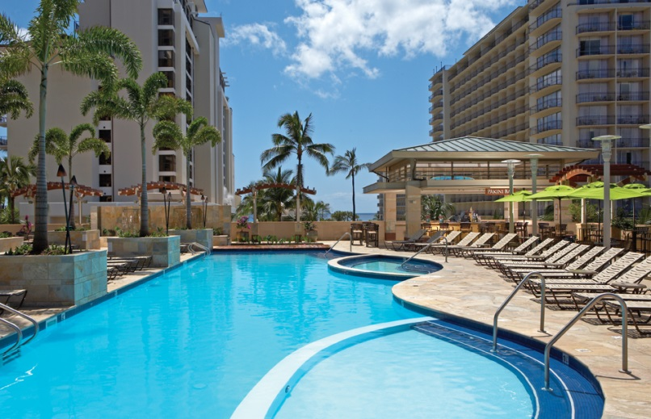
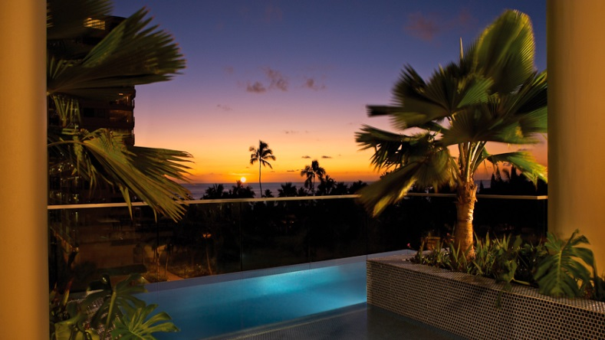
My pools and Spa

Slide 5
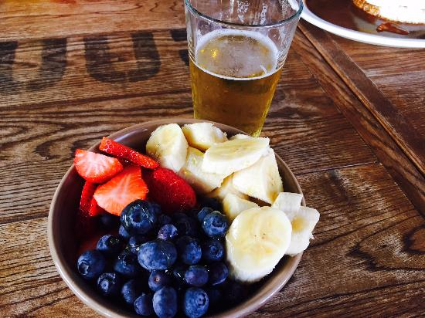
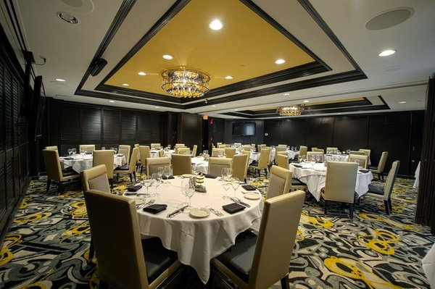
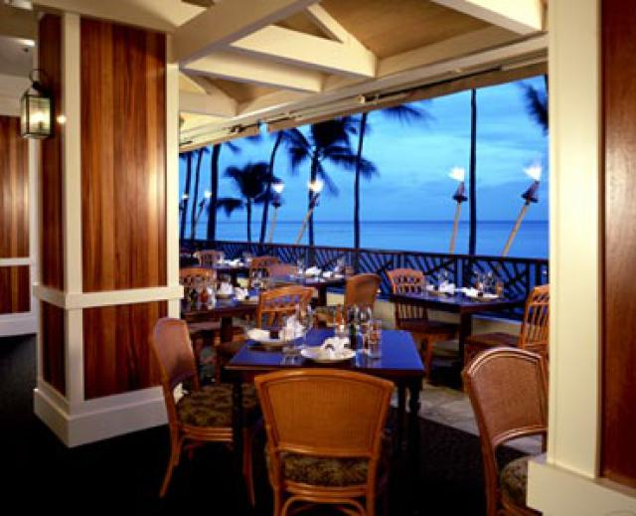
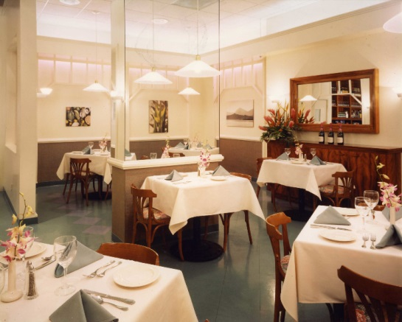
Dining
These are the places I’m going to be eating at
Hula grill Waikiki
Morton’s steak house
Duck’s bistros
Goofy café and dine

Slide 6
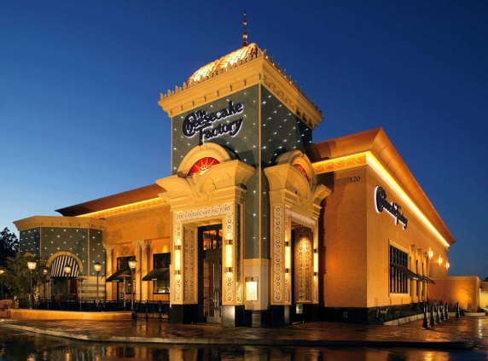
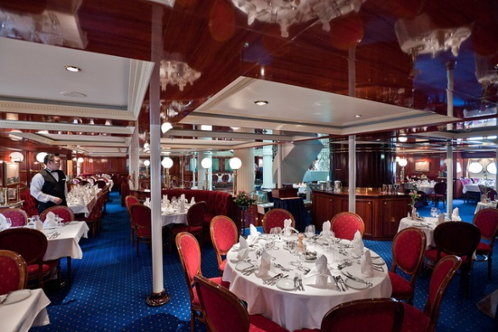
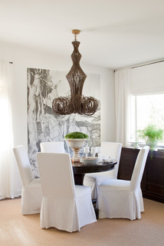
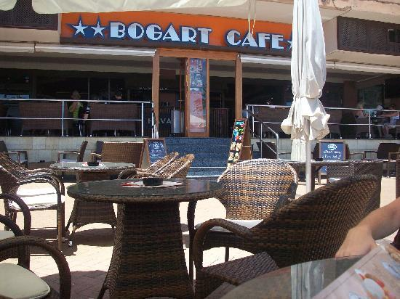
Dining/2
These are some other places I’m going to be eating at
Royal kitchen
Cheesecake factory
Bogarts café and espresso bar
Cukoo coconut

Slide 7
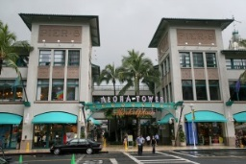
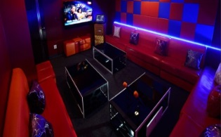
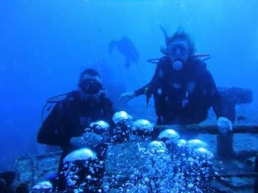
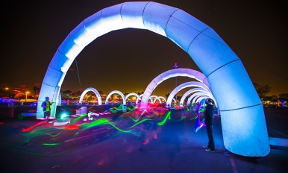
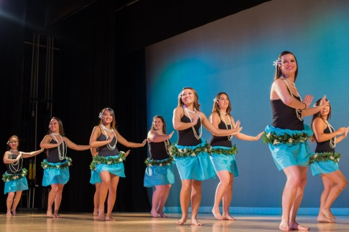
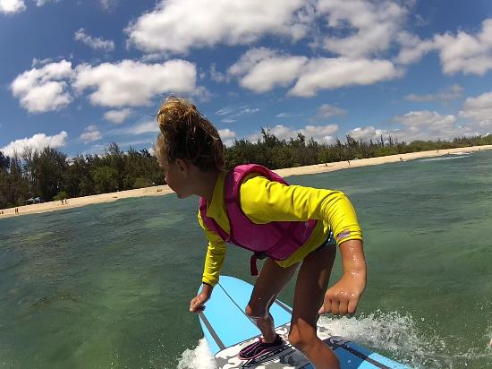
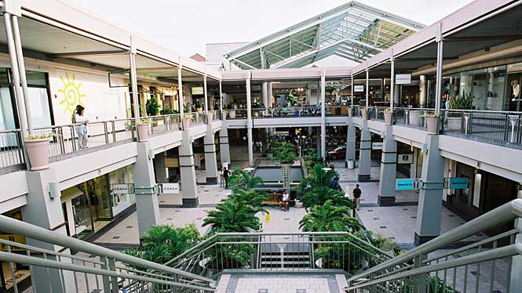
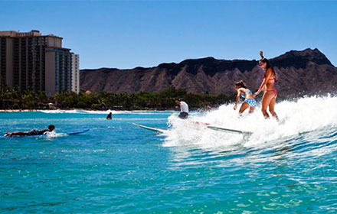
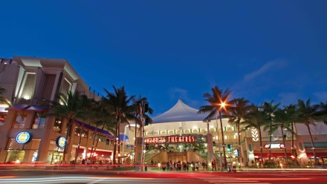
Entertainment
Air park karaoke $25
Aloha sub club $15
Blue rush surf school $55
Rainbows Cluba $290
Oahu surf lessons $150
Susan page
Modeling $185
Entry package to glow bash $ 39
Aloha tower market
Ward center
Hawaii’s shopping center

Slide 8
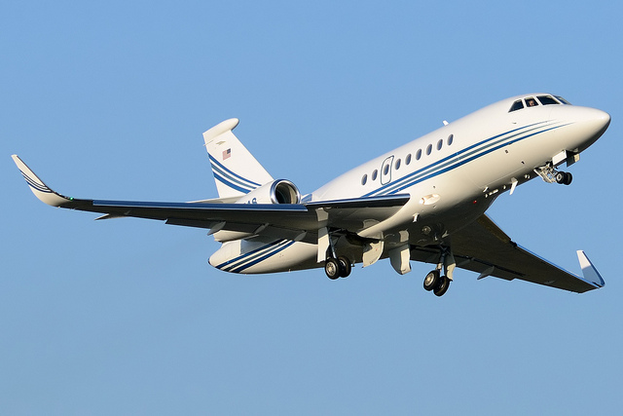
flights
8:25 leave Winnipeg to go to Calgary
10:15 leave Calgary to go to Vancouver
6:00 am leave Vancouver to go to Seattle
8:15 am leave Seattle to go to Honolulu Hawaii
And all of my Flights will cost $1,218
I have three lay overs but thank goodness I don’t have to book 2 hotels

Slide 9
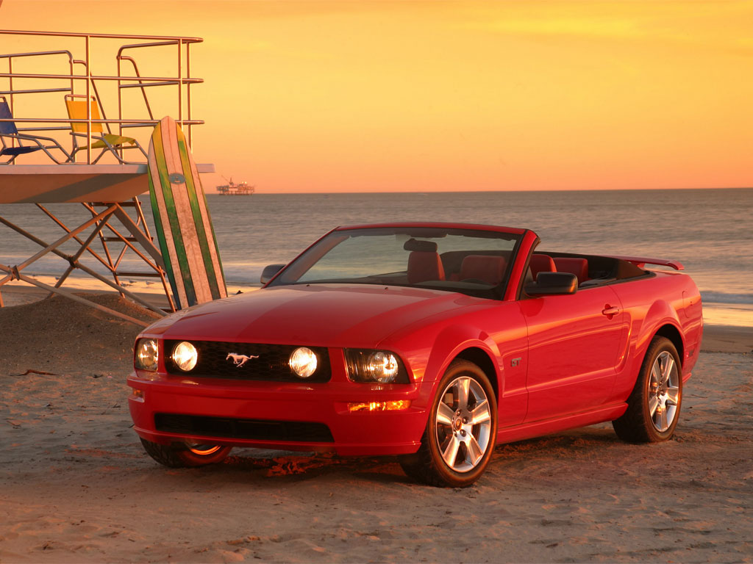
How I’m going to get around.
I’m going to be driving a red standard convertible
And its going to cost $1,104

Slide 10
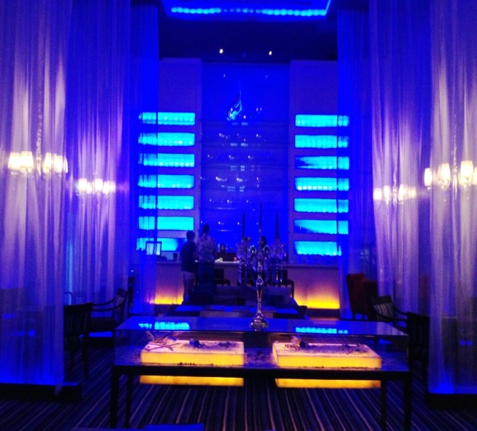
Movie theaters in hawii
The Haumana
Blue ribbon screen
Silver screen

Slide 11
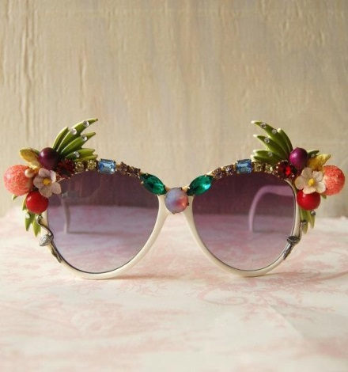
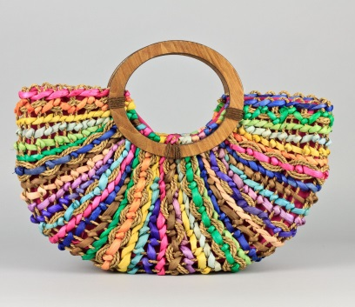
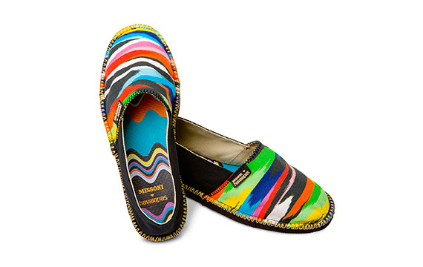
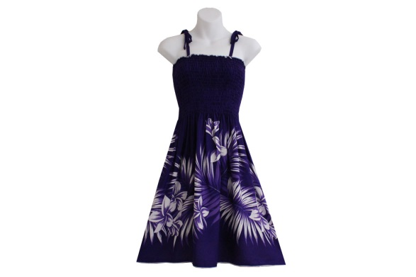
Why I choose to go to hawaii
I choose to go to hawaii because I have never been there and beacause I love their pretty dresses and surfing and they have a lot of cool eating places and their hotels have amazing views I just really wanted to go and that’s why I choose hawaii!

