Slide 1
Amber’s Dream Vacation

Slide 2
How much will it cost ?
It will cost $820/ night. So you will have to pay altogether for a week that will cost up to $5740. If you only wanted to stay for two days it will cost $1640.

Slide 3
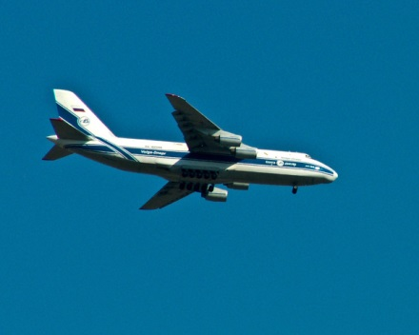
How do I get there ?
I would get there by taking a car to Winnipeg and fly out to Toronto to Orlando.
to

Slide 4
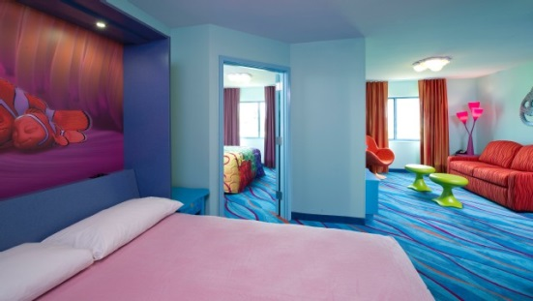
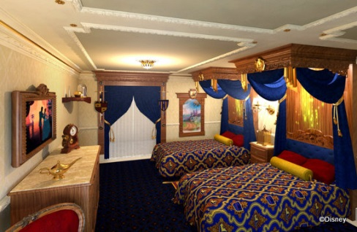
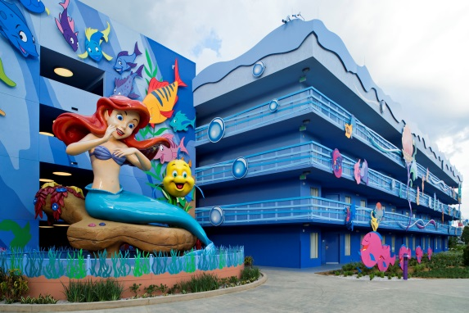
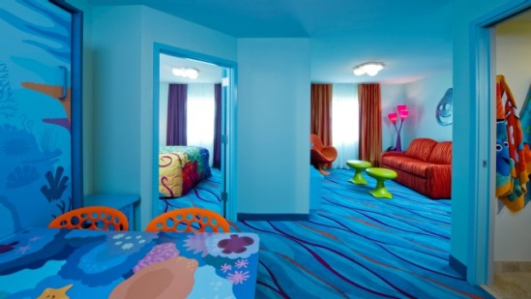
My hotel Room.
The hotel is at the Disney World Resort Hotel. It would cost $800/night. If you want to go for two days it will cost $ 1640.

Slide 5
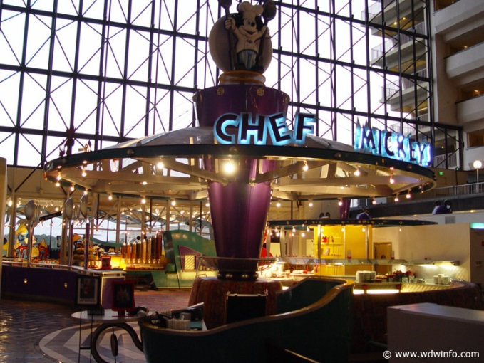
Dining
At the dining, I would go to Chef Mickeys. I would love to taste their burgers and fries. Also the mac and cheese. Chef Mickey will open at 7:00- 11:30 am, 5:00-9:30 pm.

Slide 6
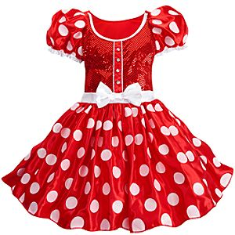
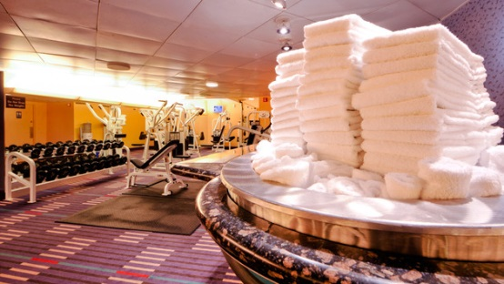
Entertainment
For my entertainment I would go shopping, the Water park, Spas and Fitness centers, events and tours, and Character Experience. At the stores I would buy a Minnie Mouse costume, a 2015 shirt , and some pants.

Slide 7
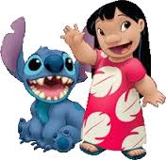
Entertainment # 2

Slide 8
Sources
. Google images
. Hhh / Disney world. Com

Slide 9
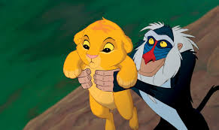
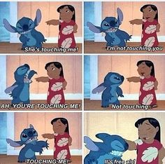
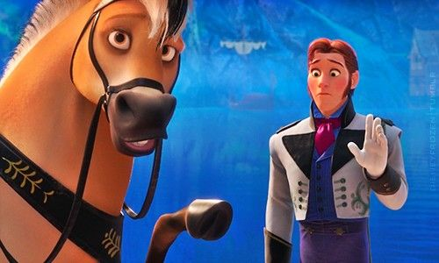

Slide 10
By Amber Mckenzie

